Slide 1


SUBSTANTIVE TESTING
BY: Ludovicus Sensi Wondabio

Slide 2

Agenda Training
Understanding substantive testing
Designing substantive procedure
Perform substantive testing
Case study – PT Ban Indonesia

Slide 3
1. UNDERSTANDING SUBSTANTIVE TESTING
Notes:
Jika tidak terdapat resiko salah saji yang material maka substantive analytical procedur dapat dianggap cukup untuk menurunkan resiko dari salah saji ke level rendah yang dapat diterima

Slide 4
1.1 OVERVIEW
Irrespective of the assessed risk of material misstatement, the auditor should design and perform substantive procedures for each material class of transactions, account balances, and disclosure. (ISA 330)
Notes:
Sekalipun pengendalian internal perusahaan sangat baik, auditor tetap harus merencanakan dan melakukan substantive prosedur, baik dengan melakukan substantive analytical review maupun substantive test of detail

Slide 5
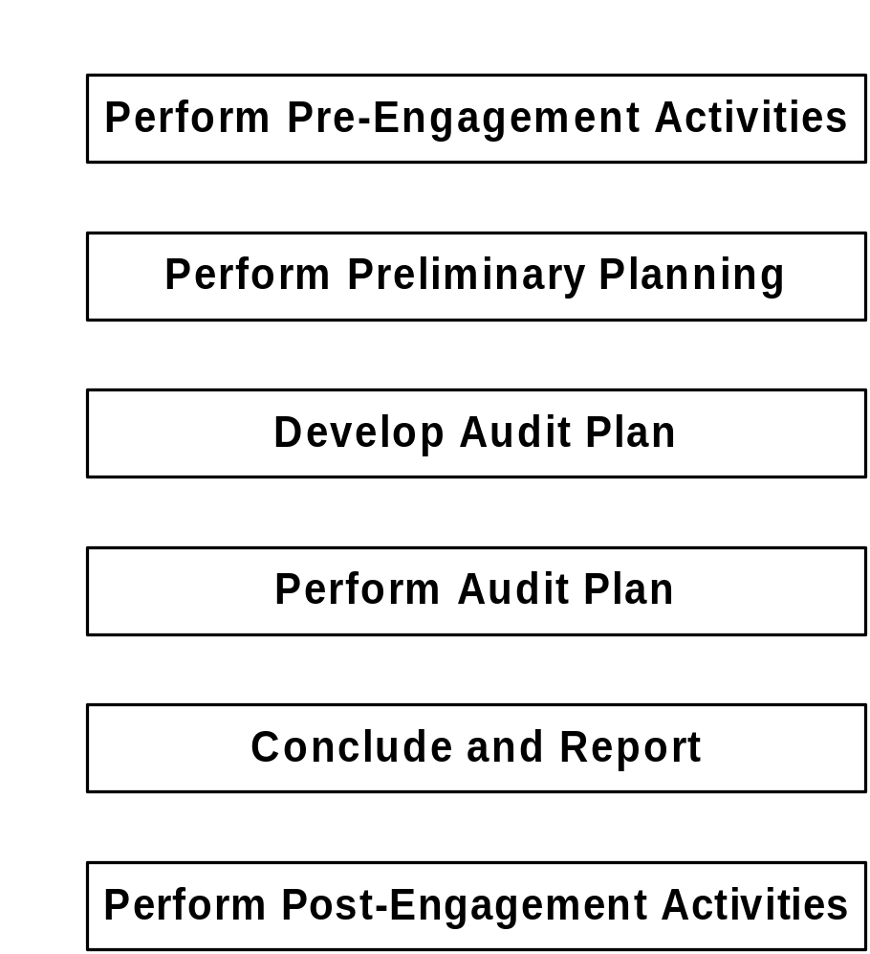
Audit Cycle
Notes:
Objective 2.2: Describe the major activities and attributes of AuditSystem/2.
Use the slide to introduce the six phases of the audit approach and to get participants to open up their audit manuals.
The audit approach has phases.
It must be used on all audit engagements.
It is cyclical, the audit process does not end, it is a rolling process.
At the assistant level, most time is spent on performing the audit plan, which is therefore the primary focus of this course.
It is important to understand the process and so time will be spent looking at a number of areas.
Direct participants to look inside the back cover of The Audit Approach manual and find the large fold out audit diagram. Ensure that they see the six phases of the audit approach on the left hand side of the chart.
Remind participants that many of the activities included in the diagram are continuous and often performed simultaneously.
Direct participants to look inside the front of the The Audit Approach manual and find the Table of Contents. Ensure that they see the linkage between the audit diagram and the chapters in the manual.
Direct participants to look inside the front of the The Audit Approach: Detailed Guidance manual and find the Table of Contents. Ensure that they see that this volume provides detailed guidance for most of the chapters in The Audit Approach manual.

Slide 6
Substantive procedures are performed in order to detect material misstatements at the assertion level, and include tests of details of classes of transactions, account balances, and disclosures and substantive analytical procedures. The auditor plans and performs substantive procedures to be responsive to the related assessment of the risk of material misstatement.

Slide 7
Methods
where internal controls are strong, auditors typically rely more on Substantive Analytical procedures (the comparison of sets of financial information, and financial with non-financial information, to see if the numbers 'make sense' and that unexpected movements can be explained)
where internal controls are weak, auditors typically rely more on Substantive Tests of Detail (selecting a sample of items from the major account balances, and finding hard evidence (e.g. invoices, bank statements) for those items)

Slide 8
Substantive Analytical Procedures
These procedures are designed to substantiate predictable relationship among both financial and non-financial data. They are mostly applicable to large volumes of transactions that tend to be predictable over time.

Slide 9
Substantive Test of Detail
These procedures are designed to gather evidence that will substantiate a financial statements amount. They are used to obtain audit evidence regarding certain assertions such as existence, accuracy, and valuation.

Slide 10
Management Assertions
Assertions about classes of transactions and events | Assertions about account balances | Assertions about presentation and disclosures
Occurrence – Transactions and events that have been recorded have occurred and pertain to the entity | Existence – Assets, liability and equity interest exist | Occurrence and right and obligations – Disclosed events and transactions have occurred and pertain to the entity
Completeness – All transactions and events that should have been recorded have been recorded | Completeness – All assets, liabilities, and equity interest that should have recorded have been recorded | Completeness – all disclosures that should have been included in the F/S have been included
Accuracy – Amounts and other data relating to recorded transactions and events have been recorded appropriately. | Valuation and allocation – Assets, Liabilities, and equity interests are included in the F/S at appropriate amounts and any resulting valuation adjustment are appropriately recorded | Accuracy and valuation – Financial and other information are disclosed appropriately and at appropriate amounts.

Slide 11
Management Assertions – Cont’d
Assertions about classes of transactions and events | Assertions about account balances | Assertions about presentation and disclosures
Classification – Transactions and events have been recorded in the proper accounts |  | Classifications and understandability – Financial and other information is appropriately presented and described and disclosures are clearly expressed
Cut off – Transactions and events have been recorded in the correct accounting period.
 | Rights and obligations – The entity holds or controls the rights to assets and liabilities are the obligations of the entity.

Slide 12
1.2 PROFESIONAL STANDARD
Notes:
Jika tidak terdapat resiko salah saji yang material maka substantive analytical procedur dapat dianggap cukup untuk menurunkan resiko dari salah saji ke level rendah yang dapat diterima

Slide 13
PROFESIONAL STANDARD
STANDARD PROFESIONAL AKUNTAN PUBLIK:
SPAP
ISA

Slide 14
SPAP Standar Pekerjaan Lapangan
Pada bagian SA 300 Standar Pekerjaan Lapangan, terdapat beberapa standar yang terkait dengan pelaksanaan substantive testing, antara lain:
  SA 312: Risiko audit dan materialitas dalam pelaksanaan audit
  SA 313: Pengujian substantive sebelum tanggal neraca
  SA 326: Bukti Audit
  SA 327: Teknik audit berbantuan komputer
  SA 329: Prosedur Analitik

Slide 15
SPAP Standar Pekerjaan Lapangan (Cont’d)
  SA 330: Proses Konfirmasi
  SA 331: Sediaan
  SA 332: Auditing Investasi
  SA 336: Penggunaan Pekerjaan Spesialis
  SA 337: Permintaan Keterangan dari Penasihat Hukum Klien
  SA 339: Kertas Kerja
  SA 341: Pertimbangan Auditor atas Kemampuan entitas dalam mempertahankan kelangsungan hidupnya

Slide 16
SPAP Standar Pekerjaan Lapangan (Cont’d)
  SA 342: Audit atas estimasi akuntansi
  SA 350: Sampling Audit
Dan beberapa standar pekerjaan lapangan yang terkait lainnya

Slide 17
ISA 330
50. The auditor’s substantive procedures should include the following audit procedures related to the financial statement closing process:
  Agreeing the financial statements to the underlying accounting records; and
  Examining material journal entries and other adjustments made during the course of preparing the financial statements.
51. When, in accordance with paragraph 108 of ISA 315, the auditor has determined that an assessed risk of material misstatement at the assertion level is a significant risk, the auditor should perform substantive procedures that are specifically responsive to that risk.
Notes:
Substantive prosedur yang dilakukan oleh auditor harus termasuk pemahaman mengenai proses pembuatan laporan keuangan, yang terdiri dari mencocokkan laporan keuangan dengan catatan keuangan dan memeriksa jurnal entries yang significant menjelang proses penyusunan laporan keuangan.
Substantive procedures harus direncanakan untuk menanggulangi risk yang ada pada klien

Slide 18
ISA 330 (Cont’d)
56. When substantive procedures are performed at an interim date, the auditor should perform further substantive procedures or substantive procedures combined with tests of controls to cover the remaining period that provide a reasonable basis for extending the audit conclusions from the interim date to the period end.
65. The auditor should perform audit procedures to evaluate whether the overall presentation of the financial statements, including the related disclosures, are in accordance with the applicable financial reporting framework.
Notes:
Jika substantive testing dilakukan pada saat interim audit maka untuk audit akhir tahun auditor harus mengcover sisa periode dengan melakukan test of control maupun substantive testing

Slide 19
ISA 500
2. The auditor should obtain sufficient appropriate audit evidence to be able to draw reasonable conclusions on which to base the audit opinion.
11. When information produced by the entity is used by the auditor to perform audit procedures, the auditor should obtain audit evidence about the accuracy and completeness of the information.
Notes:
Jika auditor memperoleh daftar/subsidiary ledger dari klien maka auditor harus meyakinkan mengenai akurasi dan kelengkapan dari informasi yang bersangkutan.

Slide 20
ISA 520
13. The auditor should apply analytical procedures at or near the end of the audit when forming an overall conclusion as to whether the financial statements as a whole are consistent with the auditor’s understanding of the entity.
17. When analytical procedures identify significant fluctuations or relationships that are inconsistent with other relevant information or that deviate from predicted amounts, the auditor should investigate and obtain adequate explanations and appropriate corroborative audit evidence.
Notes:
Analytical procedures tetap harus dilakukan untuk mengidentifikasi significant kenaikan atau penurunan yang dapat mengindikasikan adanya hal-hal yang perlu diperhatikan selama audit.

